Slide 1
Digital Marketing
By Anuj Tanwar
www.anujtanwar.com

Slide 2
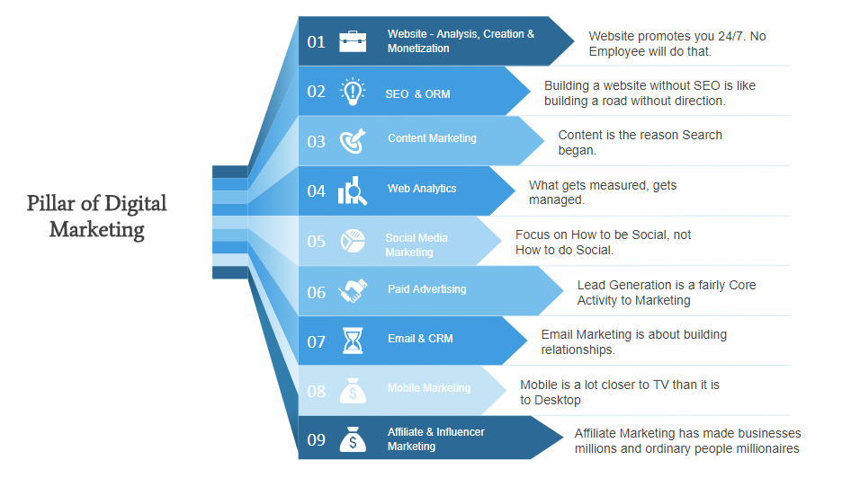

Slide 3







Website - Analysis, Creation & Monetization
Website Analysis
A. Analysis
Keyword Analysis
Visitor Tracking
Website Content
B. Creation
Landling Pages
Blog
Lead Conversion
C. Monetization
Website Traffic
Product & Services
Google Anayltics
D. Analytics
Webmaster tool
Google Tag Manager
Word Press
E. Tools
Blogger
Mobirise & AWS

Slide 4









SEO &
ORM
  Quality
  Relevant
  Word count
  Viral
  Marketing
  Engagement
  Design
  Interface
  Experience
Social
Content
Usability
search
engine
optimization
Analytics
Link Building
Keywords
  Research
  On-page optimization
  Primary and secondary
  Trends
  Forecast
  Case Studies
  Natural links
  Article
  Exchanges

Slide 5

Keyword Planner
Google Coorelate
Keyword
Research
LSI Kewords
Transcational
Content Marketing
Duplicate
Information
Content Direction
Web Content
Common
Navigational
Unique
Google Updates
Strategy
Semrush
Blog

Slide 6










WEB ANALYTICS
STUDY WEBSITE TRAFFIC
1
Competitor or Website Analysis
2
Tools
1
2
- Google Analytics
- Webmaster Tool
- Google tag manager
- semrush
- Traffic
- Time spend
- Keywords
- Bounce Rate
4
3
4
Visitor Tracking
3
Reporting
- Data Studio
- Lucky Orange
- Heatmap
- User Behaviour

Slide 7


Facebook
HASTAGS
Youtube
SOCIAL
MEDIA
MARKETING
PERSONAL
SOCIAL
NETWORKS
Twitter
Instagram
VIDEO AND IMAGE
SHARING
Linkedin
Snapchat
Google+
Vine
SOCIAL MEDIA
REVIEW SITES
Pinterest
Wordpress
CONTENT
SHARING
BLOGGING
Digg
Tumblr
Blogger
Slideshare
LiveJournal

Slide 8



PAID
ADVERTISING
GOOGLE ADWORDS
Other Platforms like bing, yahoo, and etc
FACEBOOK & INSTAGRAM
ADS MANAGER
QUORA, LINKEDLN, TWITTER AND ETC
AMAZON & FLIPKART PAID CAMPAIGN

Slide 9


Email Marketing
&
Customer
Relationship
Management
E- Newletters
Tools
Emailer
Email Automation
Templates
Multi level
Content
Lead Conversion
EMAIL
&
CRM
Lead Management
Purchase
Communication
Build Loyalty
From stranger to visitor
DataBase
Customer
ON Going
Support
R & D

Slide 10

MOBILE
MARKETING
SMS Marketing
QR Codes
PUSH Notifications
App Based Marketing
Bluetooth
Online ads
Proximity Service

Slide 11







Pay per Commission
Find Products
Dropshipping
Promote Products
Affiliate
Traffic
Market place
Track Sales
Blog or Website
Earn Comission
AFFILIATE & INFLUENCER
MARKETING
Influencer Placement
Define & Discover
Innovative Content Strategy
Monitor
Influencer
Action Plan
Brand Consulting
Take Acton
Engagement Support
Measure

Slide 12







SEO
Social Media
Objective
Affiliate Marketing
Blog
Link Prism
Hidden Content
Spamming
Gateway Pages
Black Head
Tricks
BLACK HEAD
MARKETING
Black Head
Tricks
Meta Keyword Stuffing
Link Farming
and many more
Cloaking
Increased ads Revenue
Better Result in search engine
Result
Get likes, Followers, Comments & all.
PENALISATION

Slide 13
Thank You
www.anujtanwar.com

